Slide 1
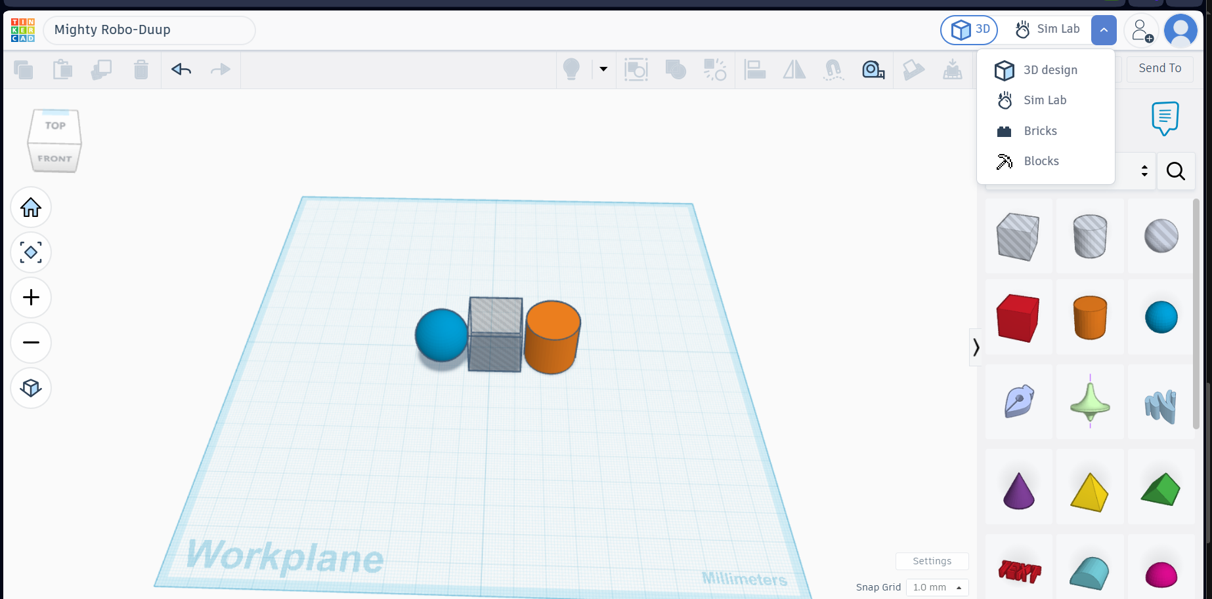
HCI Focus — Tinkercad Interaction Elements
Tinkercad — Mighty Robo-Duup
1
Shape Library
Drag-and-drop 3D primitives onto the workplane, lowering the skill barrier for beginners.
3
1
Navigation Controls
Home / zoom / orbit icons give direct camera manipulation to inspect the model from any angle.
2
2
3
Top Toolbar
Icon-based quick actions (undo, align, mirror) give instant visual feedback on available edits.
Reflection — HCI Change: I'd add a hover tooltip on each shape icon in the sidebar (e.g. "Cylinder – click to add"), since new users may not know what an icon does until after they've already dragged it onto the workplane.
MUHAMMAD ZUNAIR • 2k24/CSE/109 • ASSIGNMENT: HCI VS COMPUTER GRAPHICS
01

Slide 2
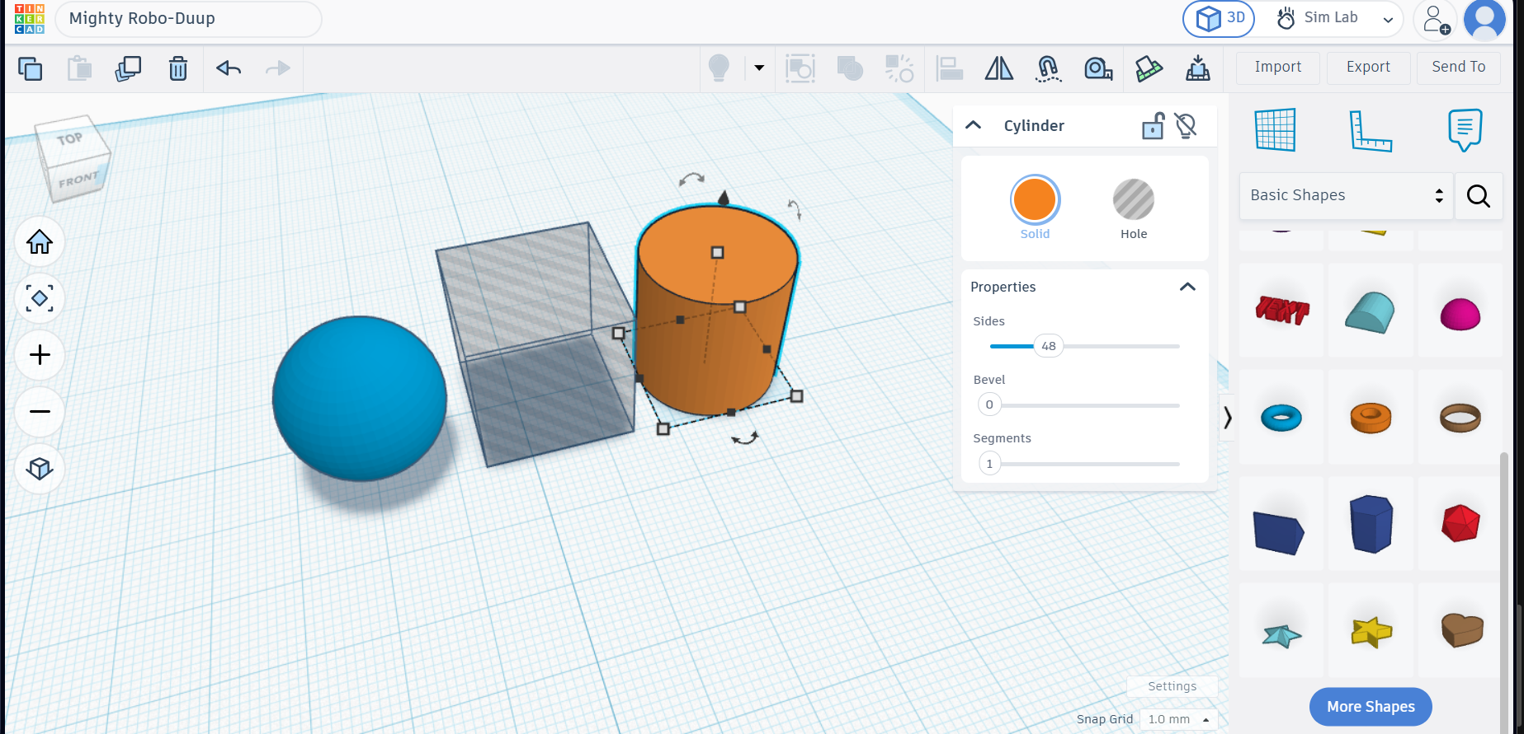
CG Focus — Tinkercad Rendering Elements
Tinkercad — Mighty Robo-Duup
1
Mesh Geometry
The Segments/Sides panel shows the cylinder is built from a defined polygon count — how curved surfaces are approximated with flat faces.
2
Perspective Camera View
The workplane converges toward a vanishing point, giving depth cues that make the flat screen read as 3D space.
3
2
1
3
Shading & Light Source
Gradient shading across the sphere/cylinder and a darker cube face reveal a single light source, creating the illusion of volume.
Reflection — CG & Interaction: Tinkercad's simple, flat-shaded CG actually helps interaction — objects stay easy to read and never distract from precise placement. Photorealistic lighting could instead soften edges and make it harder to judge exact alignment.
MUHAMMAD ZUNAIR • 2k24/CSE/109 • ASSIGNMENT: HCI VS COMPUTER GRAPHICS
02

